Slide 1
DSC 530 – Data Exploration and Analysis
Steven Miller

Slide 2
Statistical Question
What factors can we use to predict the wait time of a theme park ride?

Slide 3
Dataset and Variables Used
TouringPlans Splash Mountain data will be explored
https://touringplans.com/walt-disney-world/crowd-calendar#DataSets
Metadata common to all datasets will also be used.
From Splash Mountain data – Date, Datetime and SPOSTMIN
SPOSTMIN is the posted wait time in minutes
From Metadata:
DATE
DAYOFWEEK
MKHOURS – the number of hours the Magic Kingdom was open on a day
HOLIDAYM – a 0-5 scale of holiday seasons, 5 being the highest (Christmas) and 0 being no holiday at all
WDWMEANTEMP – average temperature of the day
WEATHER_WDWPRECIP – precipitation recorded for the day
inSession_wdw – percentage of schools within the Walt Disney World audience that are in session

Slide 4
Hypothesis
I expect to find:
A positive relationship between weekends and wait times
A positive relationship between mean temperature and wait times
A positive relationship between holidays and wait times
A negative relationship between rainfall and wait times
A negative relationship between the percentage of schools in session and wait times
No relationship between the number of hours the park is open and wait times.

Slide 5
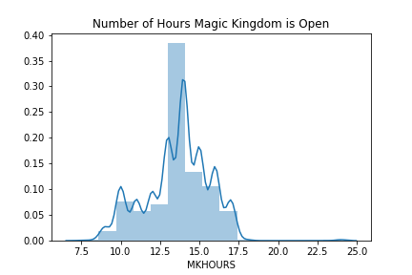
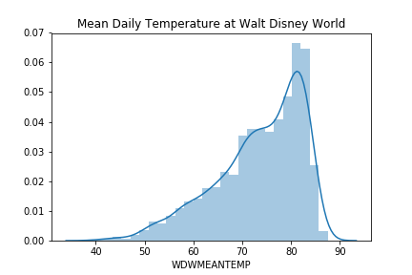
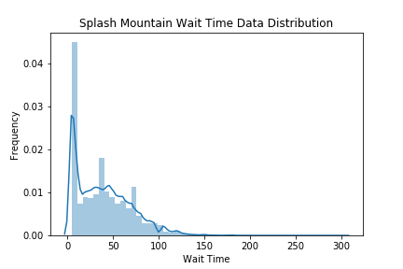
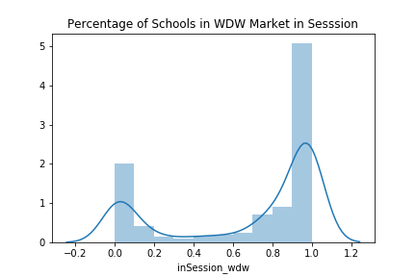
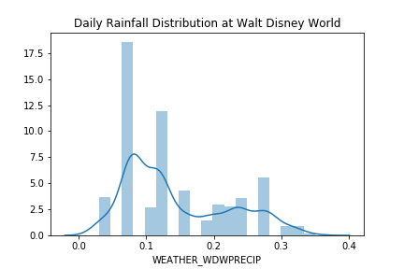

Slide 6
Summaries
Variable | Min | Max | Mean | Median | Std. Dev. | Skew | Kurtosis
SPOSTMIN | 5 | 300 | 39.45 | 35 | 30.09 | 0.829 | 0.476
MKHOURS | 7.5 | 24 | 13.63 | 14 | 2.05 | -.204 | .387
WDWMEANTEMP | 39.75 | 87.49 | 73.44 | 75.16 | 8.93 | -.878 | .164
WEATHER_WDWPRECIP | 0.03 | 0.35 | .144 | .12 | .078 | .719 | -.684
inSession_WDW | 0 | 1 | .679 | .9 | .39 | -.866 | -1.018
Outliers
Few outliers are present in these variables, however two stand out.
The number of hours the Magic Kingdom has a maximum value of 24, over five standard deviations above the mean. This is a result of an annual event that was previously held where the park was open from 6 AM to 6 AM.
The posted wait time goes as high as three hours, despite a mean value of only 39.45. These are likely very extreme and unusual circumstances.

Slide 7
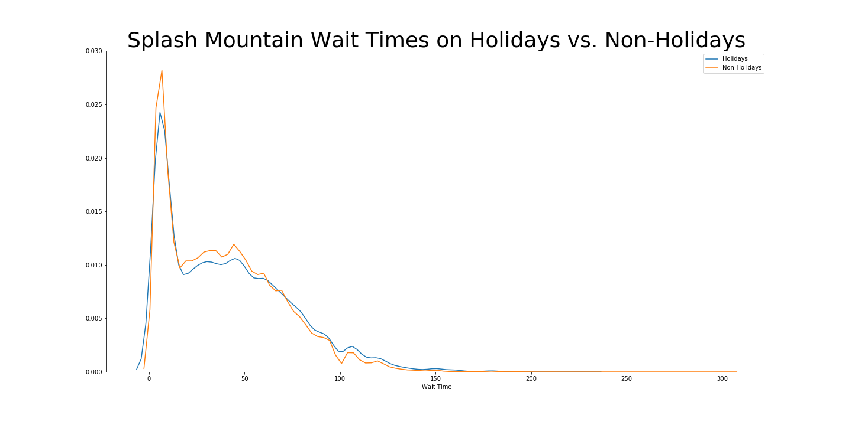
Holidays vs. Non-Holidays

Slide 8
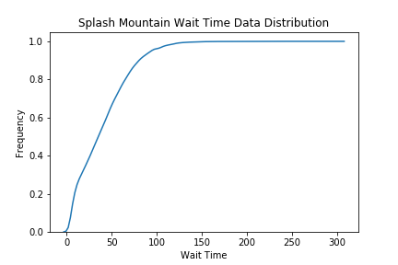
CDF
From this CDF we can see nearly all of our values exist below around the 100 minute mark. This tells us that wait times above this point are outliers.

Slide 9
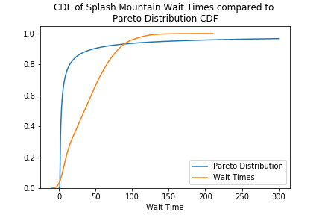
Wait Times and the Pareto Distribution
While not a perfect fit, the distribution of wait times fits the pareto distribution’s idea that most of the data lies in a small portion of the distribution.

Slide 10
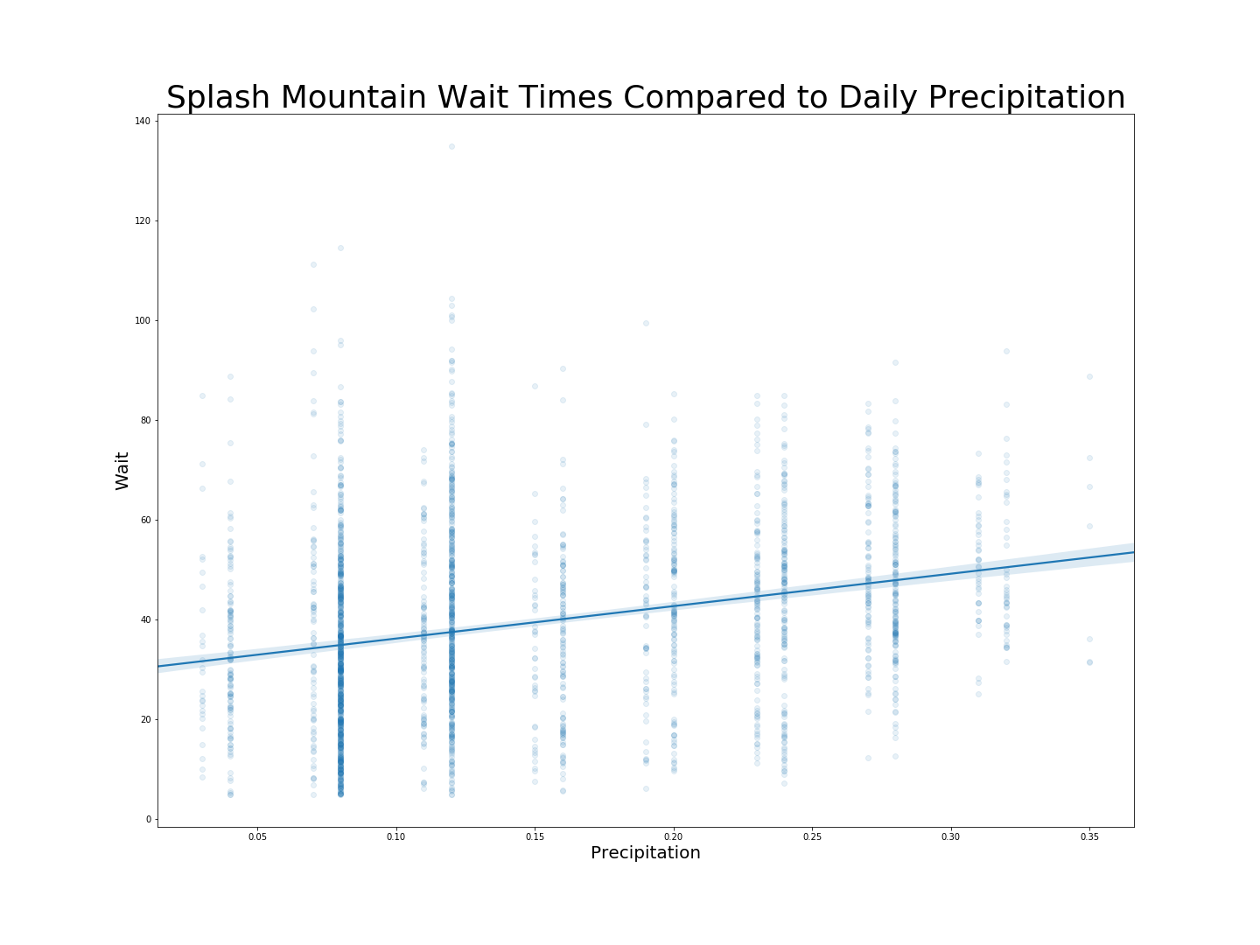
Wait Times vs. Rainfall
Spearman R – 0.295
A positive relationship, however not a strong one.

Slide 11
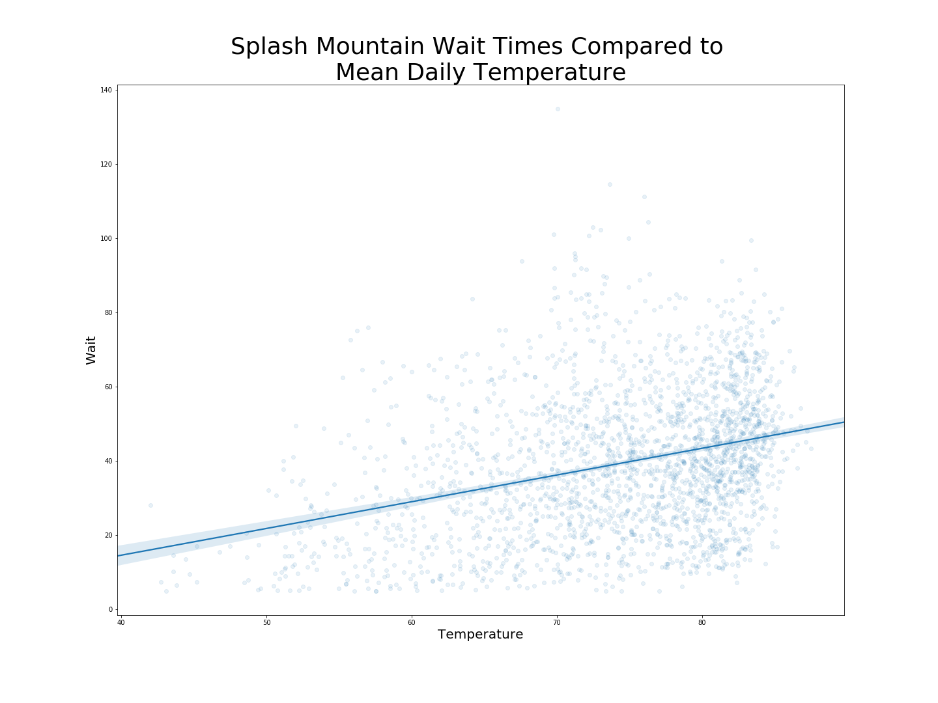
Wait Times vs. Temperature
Spearman R – 0.320
A slightly stronger positive relationship

Slide 12
Correlation Hypothesis Tests
Wait Time vs. Temperature |  | Wait Time vs. Rainfall
p-value | < 0.001 | p-value | < 0.001
Actual Correlation | 0.321 | Actual Correlation | 0.271
Max Correlation Seen in Testing | 0.067 | Max Correlation Seen in Testing | 0.074

Slide 13
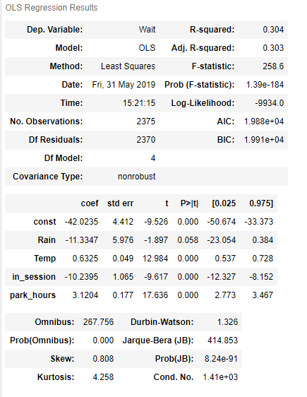
OLS Regression
This model uses precipitation, temperature, percentage of in-market schools in session, and park hours to explain 30.3% of the variance in mean daily wait times for Splash Mountain.
Holiday rank was also tested, but had a large p-value (0.36) and was excluded from the final model as it did not improve the results.

